Slide 1
Adherence to General Data Protection Regulation (GDPR)
Student Name
Institution Affiliation

Slide 2
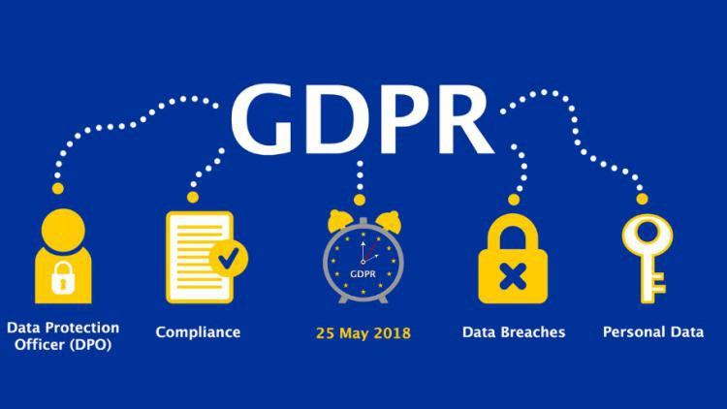
Introduction
Confidential of personal data is essential
As data stored continues to increase, more protection is needed
Protection eases data portability
Enable creation of strong recovery mechanisms
Notes:
In every organization, Data protection is essential. Every stakeholder within the organization requires their personal data kept confidential. As company amount of data grows, the company would require more protection hence the need to adhere to GDPR. When data is well protected, the organization will be able to transfer data from one application program to another without any risk of data loss. Also, adherence to the protection regulation would help the company create strong data recovery mechanisms hence reducing risk of personal data loss.

Slide 3
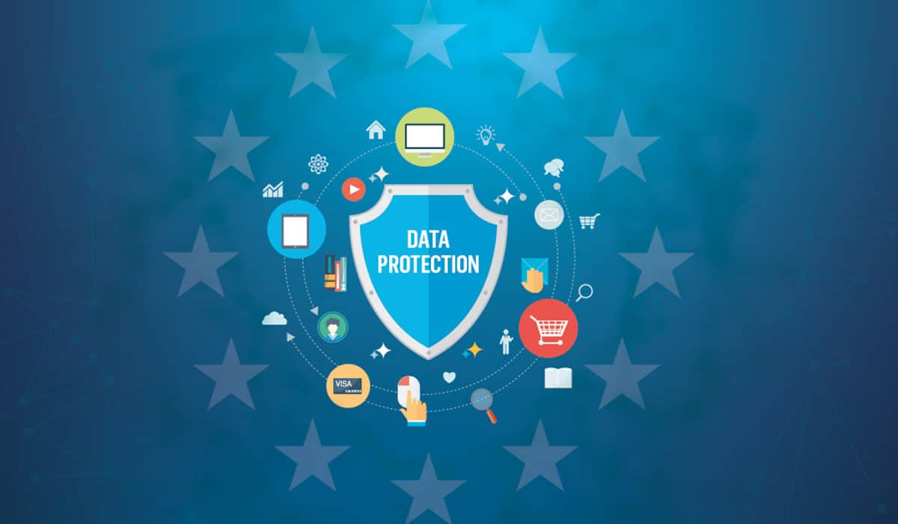
Importance of GDPR
Control to organization over personal data
Simplify regulatory environment
Effective processing of personal data
Improves technical and organizational measures
Notes:
GDPR is essential in every organization including our organization. GDPR will help our organization to be much in control over personal data hence ensuring that there is not time when data is compromised. Additionally, GDPR will help our organization in the simplification of the regulatory environment hence few personnel will be responsible for data safety mechanisms. GDPR will also provide us with the necessary requirements that will help us to effectively process all personal data. As controllers and processors of personal data, GDPR will make us always to ensure that there are effective technical and organizational measures in the organization (Chua, Herbland, Wong & Chang, 2017).

Slide 4
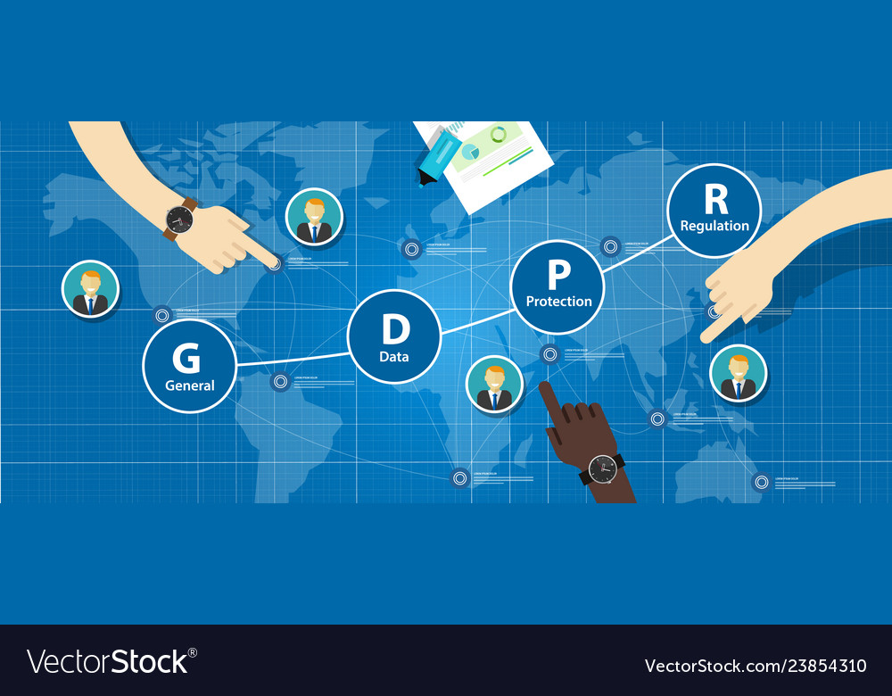
GDPR compliance
Reduce risk of data breaches
Gathering personal data legally and under strict conditions
Protection of personal data from exploitation and misuse
Respect of rights of data owners
Notes:
It is important that organizations comply with GDPR since there is need to minimize data breaches that can happen any time. Data can get lost, stolen or fall on wrong hands of peoples hence the need for protection. Compliance to GDPR helps organizations to legally gather personal data under strict conditions to avoid data breaches. Some of the staff on an organization may decide to exploit and misuse the personal data. This can be avoided through compliance with GDPR. Lastly, an organization will be in the position to respect the rights of the data owners of they comply with GDPR (Lovell & Foy, 2018).

Slide 5

GDPR Importance to Organization
Slim-lining data legislation
Provides data protection by design in new products and technologies
Encourages organization to adopt techniques like 'pseudonymization'
Notes:
GDPR is much essential to the organization as a whole. The organization much benefits since all data legislations are slim-lined hence easy to adhere to. Additionally, data protection is assured even when it comes to production of new products and technologies within the organization. Through GDPR, an organization is in the position of adopting new techniques which would much benefit the organization in personal data collection and analyzing (Goddard, 2017).

Slide 6

GDPR Importance to consumers
Right to know when data has been hacked
Easier access to own personal data
Easier way to opt out of organization deals
Freedom to request for permanent deletion of personal data
Notes:
GDPR has great benefits to the consumer. The regulation provide the right to the consumer to be informed when data has been hacked so that they can take the appropriate measure to ensure their data is not abused. Also, consumers have the right to be update on the usability of their data and be able to access it anytime. With aces to their data, consumers remain in a good position to opt out of the organization deals. When the consumer does not have any further transactions with the organization, they have the freedom to ask the organization to permanently delete their personal data and never to be used again.

Slide 7
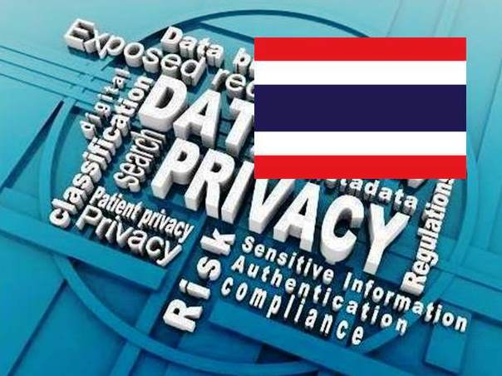
Notification About a Breach
Reporting a breach should be within 72 hours
Customers and the Public must be notified of all serious breaches
Notes:
Under GDPR, organizations are required to report any form of personal data breach within 72 hours to the relevant supervisory bodies. Additionally, if a breach is serious, the organization need to let the consumers and the public aware. The consumers have the right to be informed of breach without undue delay (Goddard, 2017).

Slide 8

Consequences of Non-Compliance
Fines ranging from 10 million euros to 4% of company’s annual turnovers
Fines depends on severity of the breach.
Notes:
Non-compliance attracts fines and penalties to the organization. the fines charged to organization range from 10 million euros to four per cent of the company's annual global turnover, a figure which for some could mean billions. However, the fines depends on the severity of the breach. Infringement of the rights of the data subjects attracts for a fine of 20 million euros while mishandling of data attracts a fine of 10 million euros (Goddard, 2017).

Slide 9
References
Goddard, M. (2017). The EU General Data Protection Regulation (GDPR): European regulation that has a global impact. International Journal of Market Research, 59(6), 703-705.
Lovell, M., & Foy, M. A. (2018). General Data Protection Regulation May 2018 (GDPR) How does it affect us?. Bone & Joint 360, 7(4), 41-42.
Chua, H. N., Herbland, A., Wong, S. F., & Chang, Y. (2017). Compliance to personal data protection principles: A study of how organizations frame privacy policy notices. Telematics and Informatics, 34(4), 157-170.

